Slide 1
Financial forecasting data analysis using excel
STUDENT NAME: ABISHEK.A.S
REGISTER NO: 422200003
DEPARTMENT: B.COM (ISM)
COLLEGE S.I.V.E.T COLLEGE

Slide 2
PROJECT TITLE
Financial forecasting data uusing excel

Slide 3


AGENDA
Problem Statement
Project Overview
End Users
Our Solution and Proposition
Dataset Description
Modelling Approach
Results and Discussion
Conclusion
3/21/2024 Annual Review

Slide 4

PROBLEM STATEMENT
Here are some potential problem statements for financial forecasting
:1. Inaccurate Revenue Projections: "Our company struggles to accurately forecast revenue, leading to inconsistent resource allocation and poor strategic planning.“
2. Insufficient Expense Prediction: "We need a reliable method to anticipate monthly expenses, enabling better budgeting and cost management.“
3. Unreliable Cash Flow Estimates: "Our business requires improved cash flow forecasting to ensure timely investments and avoid liquidity crises."
4. Ineffective Portfolio Optimization: "We seek a data-driven approach to optimize investment portfolios, maximizing returns while minimizing risk.“
5. Limited Scenario Analysis: "Our organization needs a flexible financial forecasting model to simulate different market scenarios and inform strategic decisions."

Slide 5

PROJECT OVERVIEW
Design and implement an accurate, reliable, and scalable financial forecasting system to enhance strategic decision-making, optimize resource allocation, and improve financial performance.
Financial forecasting model(s) with documented methodolog. Data visualization dashboard for key stakeholders
2. Automated reporting system for regular forecasting updates
3. Scenario analysis tool for sensitivity testing
4. Model performance evaluation and refinement6. User training and documentation

Slide 6

WHO ARE THE END USERS?
Chief Financial Officer (CFO)
2. Financial Planning and Analysis (FP&A) team
3. Accounting and finance staf
4. Executive management (CEO, COO, etc.)
5. Department heads (e.g., sales, marketing, operations)
6. Budget managers
7. Financial analysts
8. Risk management team
9. Treasury management team
10. Strategic planning team

Slide 7

OUR SOLUTION AND ITS VALUE PROPOSITION
10-20% improvement in forecast accuracy
2. 5-15% reduction in costs
3. 10-25% increase in revenue
4. 20-30% improvement in cash flow management
5. 5-10% reduction in financial risk

Slide 8
Dataset Description
Dataset Name: Financial Forecasting DatasetDataset
Type: Time-series, Panel
DataDescription: This dataset contains historical financial data for a company/organization, including income statements, balance sheets, and cash flow statements. The data is used to train and test financial forecasting models.
Date (YYYY-MM-DD)
2. Assets (Current, Non-Current)
3. Liabilities (Current, Non-Current)
4. Equity
5. Cash and Equivalents
6. Accounts Receivable
7. Accounts Payable

Slide 9
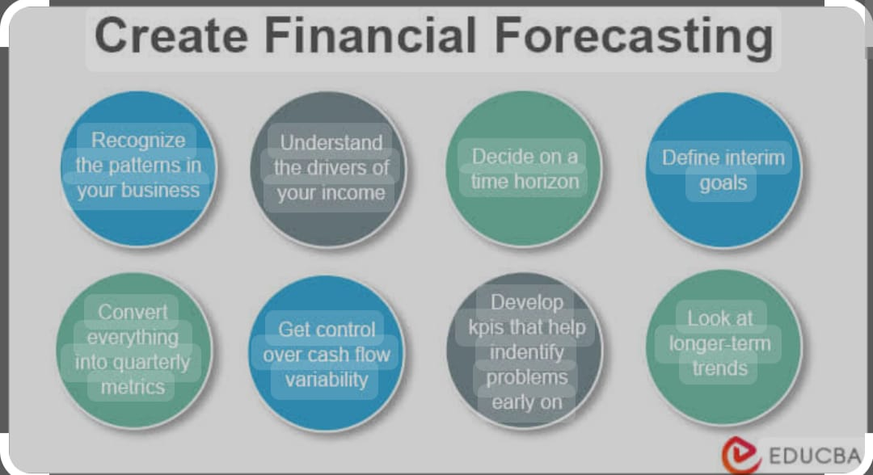

THE "WOW" IN OUR SOLUTION
3/21/2024 Annual Review
9

Slide 10
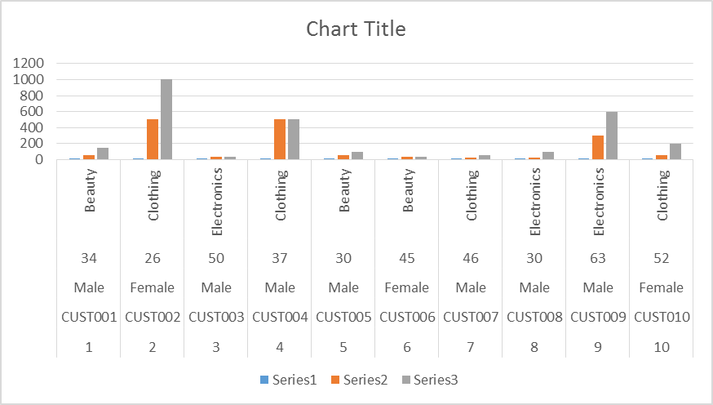
MODELLING
10

Slide 11
RESULTS
1 | CUST001 | Male | 34 | Beauty | 3 | 50 | 150
2 | CUST002 | Female | 26 | Clothing | 2 | 500 | 1000
3 | CUST003 | Male | 50 | Electronics | 1 | 30 | 30
4 | CUST004 | Male | 37 | Clothing | 1 | 500 | 500
5 | CUST005 | Male | 30 | Beauty | 2 | 50 | 100
6 | CUST006 | Female | 45 | Beauty | 1 | 30 | 30
7 | CUST007 | Male | 46 | Clothing | 2 | 25 | 50
8 | CUST008 | Male | 30 | Electronics | 4 | 25 | 100
9 | CUST009 | Male | 63 | Electronics | 2 | 300 | 600
10 | CUST010 | Female | 52 | Clothing | 4 | 50 | 200
11

Slide 12
conclusion
Financial Forecasting ConclusionFinancial forecasting is a crucial component of business decision-making, enabling organizations to make informed strategic choices, optimize resources, and mitigate financial risks. By leveraging advanced predictive analytics, machine learning algorithms, and real-time data integration, financial forecasting solutions can provide accurate and reliable projections.

